Slide 1
SYSC 5405 Project: Logistic Regression
Tingjun Liu, Ye Tao

Slide 2
Agenda
Review logistic regression
Experiment Design:
Data pre-process
Training:
Undersampling + Bagging
Active Learning
Results Validation
Results

Slide 3
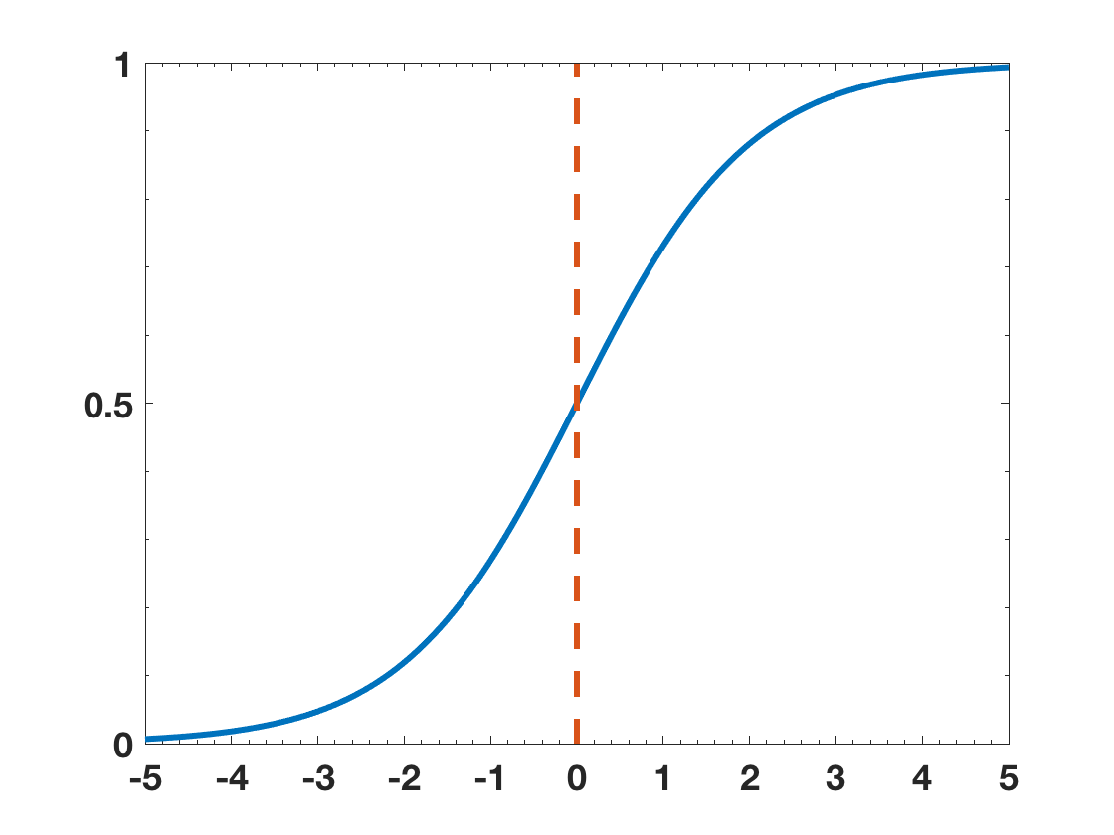

Review: Logistic Regression
$P\left(A | X\right)= \frac{1}{1+e^{−α^{T}x}}$
$P>threshold, P=class ′A′$
$P<threshold, P=class ′B′$

Slide 4
Experiment Design: Data Pre-process
CFS subset evaluator + Greedy step
55 attributes selected
How to handle missing data?
Predicted value will be 1 when having missing data(-9999)
Drop or merge
40 attributes selected
70% Training, 30% Validation.

Slide 5
Experiment Design: Overview

Slide 6
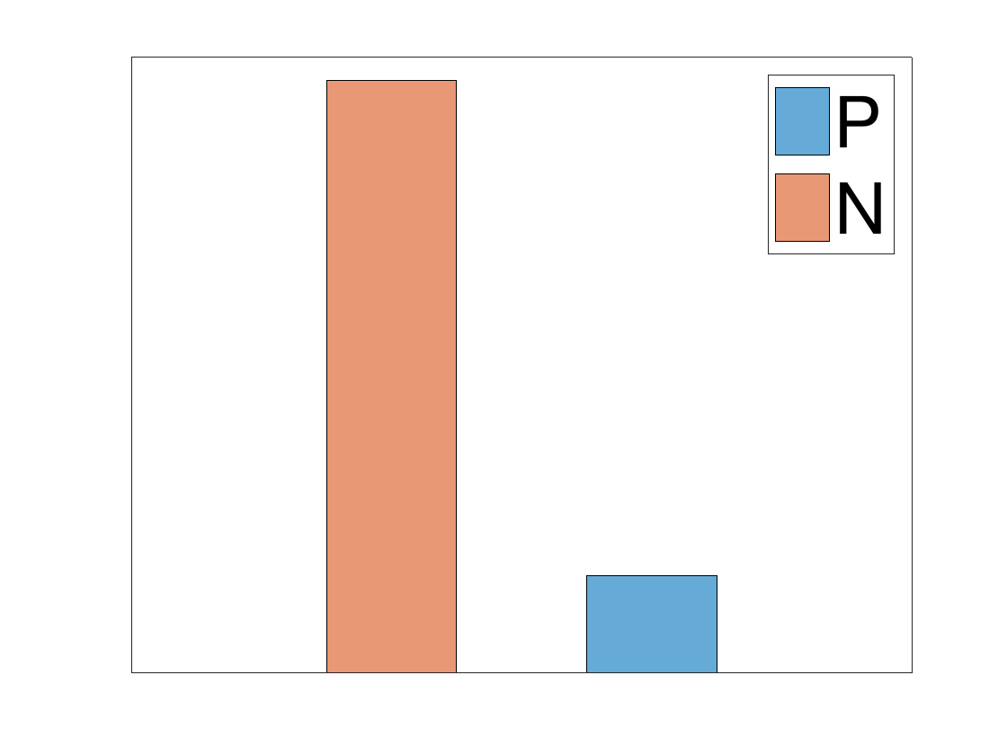
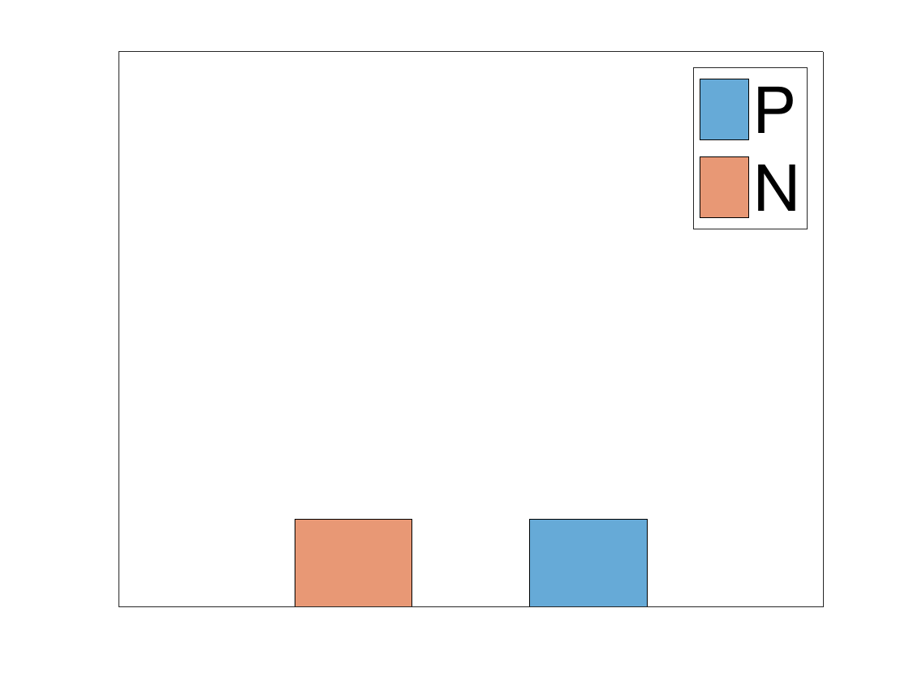
Experiment Design: Undersampling+Bagging

Slide 7
Experiment Design: Undersampling+Bagging (CONT.)

Slide 8
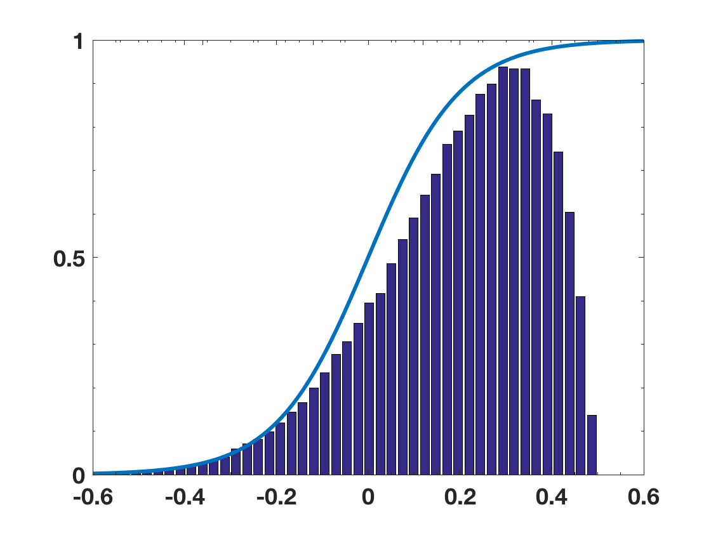
Experiment Design: active learning
50%
25%
25%

Slide 9
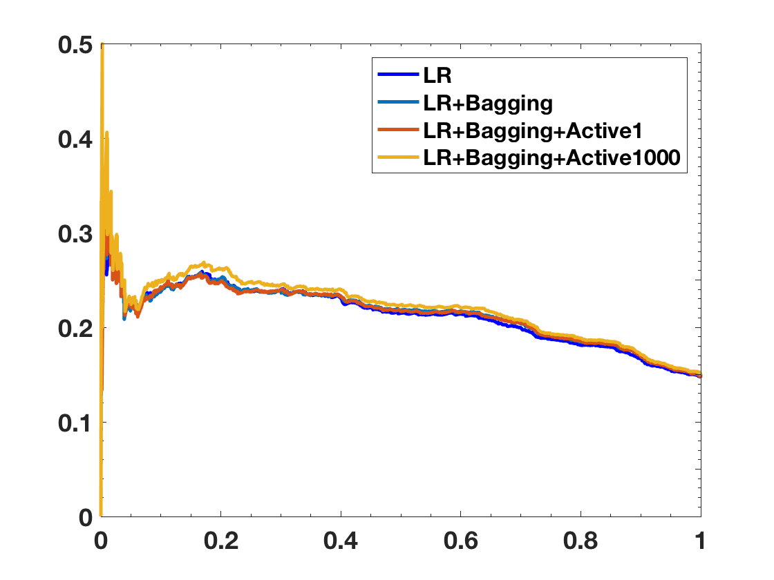
Precision-Recall Curve
Precision
Recall

Slide 10


Experiment Design: result validation (Bootstrap)
$Precision =30.43\%±2\%$
Student test, p = 1
$recall=30.25\%±1.79\%$
Student test, p = 1

Slide 11
Thank you!

